Slide 1
Class : Game Playing 2
Joshua Durso-Finley Course code:
joshua.durso-finley@mail.mcgill.ca

Slide 2
Outline

Slide 3

Table of Contents
Game Theory
Notes:
‹#›

Slide 4
Game Theory
Not all games are the same
Games can be iterative
Games can be simultaneous
Games may not be zero sum
Notes:
‹#›

Slide 5



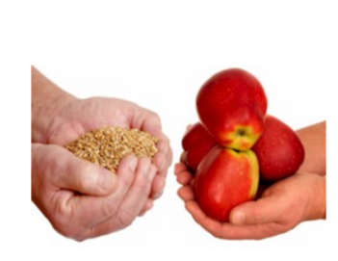
Game Theory
Which games are variable sum, simultaneous?
Notes:
‹#›

Slide 6
Game Theory
Rock-Paper-Scissors
2-player, one-turn, simultaneous-move games
Best strategy for rock?
Notes:
‹#›

Slide 7
RPS normal form
R P S
½ , ½ | 0,1 | 1,0
1,0 | ½ , ½ | 0,1
0,1 | 1,0 | ½ , ½
R P S
Notes:
‹#›

Slide 8
Strategies
Strategy=A specification of what to do in every single non-terminal state
Pure vs Mixed strategies
Make actions according to a probability
Examples
Trading: I’ll accept an offer of $20 or higher, but not lower
Notes:
‹#›

Slide 9
Best Strategy for RPS?
Depends on what the opponent is doing
If we knew what they were going to do then it would be an optimization problem.
We could search for a strategy that wins
Notes:
‹#›

Slide 10
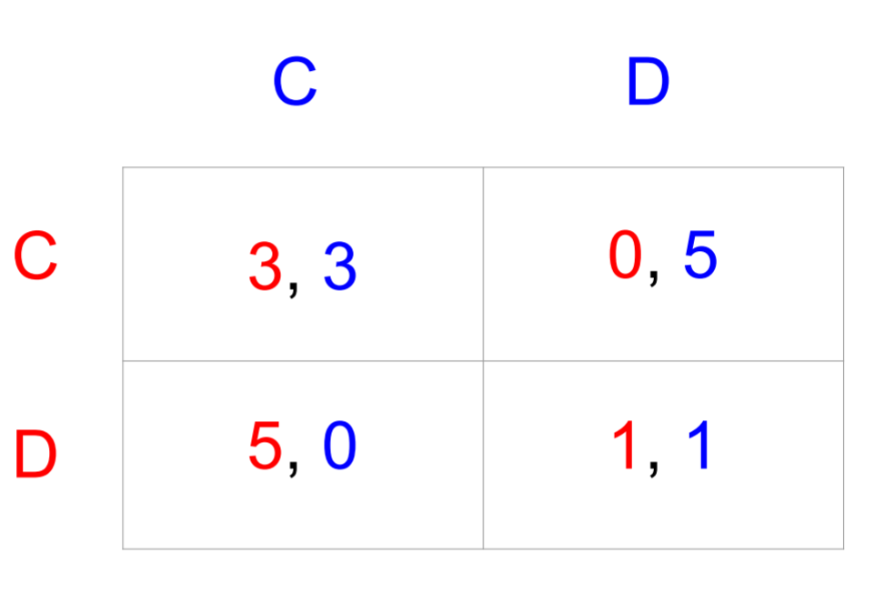
Dominated Strategies
A strategy dominates another strategy if it always gives a higher payoff
Notes:
‹#›

Slide 11
Dominated Strategies
If the blue player chooses D what should the red player choose?
Notes:
‹#›

Slide 12
Dominated Strategies
If the blue player chooses C what should the red player choose?
Notes:
‹#›

Slide 13
Dominated Strategies
If the blue player chooses C what should the red player choose?
Notes:
‹#›

Slide 14
Dominated Strategies
Knowing the Red player will never play C what should the blue player play?
Notes:
‹#›

Slide 15
Dominated Strategies
Knowing the Red player will never play C what should the blue player play?
Notes:
‹#›

Slide 16
Dominated Strategies
The dominant strategy is to both play D
Notes:
‹#›

Slide 17
Iterated Dominance
 | L | C | R
U | 6 1 | 1 0 | 6 2
M | 1 4 | 0 5 | 5 5
D | 3 4 | 4 3 | 2 0
Notes:
‹#›

Slide 18
Iterated Dominance
 | L | C | R
U | 6 1 | 1 0 | 6 2
M | 1 4 | 0 5 | 5 5
D | 3 4 | 4 3 | 2 0
Notes:
‹#›

Slide 19
Iterated Dominance
 | L | C | R
U | 6 1 | 1 0 | 6 2
M | 1 4 | 0 5 | 5 5
D | 3 4 | 4 3 | 2 0
Notes:
‹#›

Slide 20
Iterated Dominance
 | L | C | R
U | 6 1 | 1 0 | 6 2
M | 1 4 | 0 5 | 5 5
D | 3 4 | 4 3 | 2 0
Notes:
‹#›

Slide 21
Iterated Dominance
Doesn’t always produce a unique solution i.e. RPS
Assumes rationality from the other player
Doesn’t necessarily produce the best outcome
Notes:
‹#›

Slide 22
Other Strategies
Ensure the best worst case scenario: The best worst case for red is picking D. The best for blue is L
 | L | C | R
U | 6 1 | 1 0 | 6 2
M | 1 4 | 0 5 | 5 5
D | 3 4 | 4 3 | 2 0
Notes:
‹#›

Slide 23
Other Strategies
Maximin assumes nothing and avoids all risk
 | L | C | R
U | 6 1 | 1 0 | 6 2
M | 1 4 | 0 5 | 5 5
D | 3 4 | 4 3 | 2 0
Notes:
‹#›

Slide 24
What is the maximin strategy?
 | L | C | R
U | 3 1 | 2 0 | 0 2
M | 4 7 | 3 6 | 1 5
D | 3 4 | 0 5 | 5 0
Notes:
‹#›

Slide 25
What is the ID strategy?
 | L | C | R
U | 3 1 | 2 0 | 0 2
M | 4 7 | 3 6 | 1 5
D | 3 4 | 0 5 | 5 0
Notes:
‹#›

Slide 26
Nash Equilibrium
Nash Equilibrium-Strategy such that players are mutually best responding
No player can do better by switching alone
Notes:
‹#›

Slide 27
Stag Hunt
 | B | S
B | 2 2 | 2 0
S | 0 2 | 3 3
Notes:
‹#›

Slide 28
Stag Hunt
Are there dominating strategies?
What are the Nash Equilibrium?
 | B | S
B | 2 2 | 2 0
S | 0 2 | 3 3
Notes:
‹#›

Slide 29
Algorithmic NashEQ
Are there dominating strategies?
What are the Nash Equilibrium?
 | B | S
B | 2 2 | 2 0
S | 0 2 | 3 3
Notes:
‹#›

Slide 30
Algorithmic NashEQ
No dominating strategies
2 Nash EQ TL and BR
 | B | S
B | 2 2 | 2 0
S | 0 2 | 3 3
Notes:
‹#›

Slide 31
Algorithmic NashEQ
No dominating strategies
2 Nash EQ TL and BR
 | B | S
B | 2 2 | 2 0
S | 0 2 | 3 3
Notes:
‹#›

Slide 32
Find Nash Equlibrium
Bold the best option for each choice of the opponent the Nash Equilibrium are where they agree
 | L | C | R
U | 9 1 | 10 6 | 1 3
M | 6 5 | 6 1 | 6 5
D | 8 1 | 4 10 | 8 10
Notes:
‹#›

Slide 33
Nash Equlibrium
If ID provides a unique solution it is a NE
There exists at least 1 NE
Notes:
‹#›

